Slide 1
Start-up Airline Analysis
Subtitle
Presentation
By Akanchha Choudhary 17-03-2020

Slide 2
Section Header 01
Subtitle

Slide 3
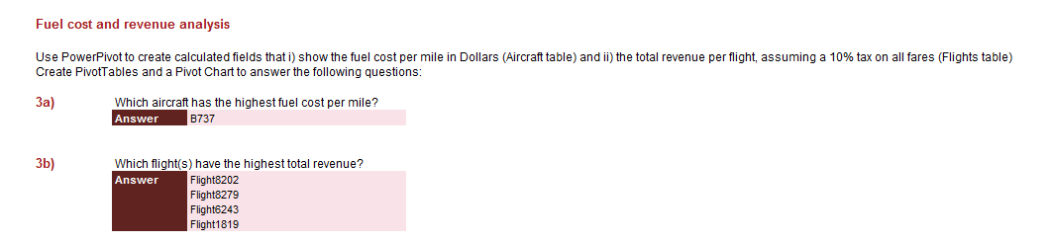
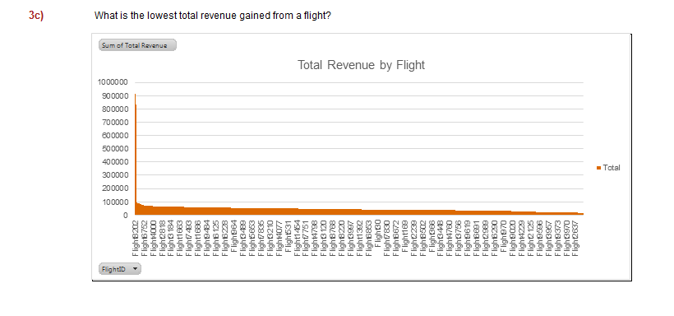
Logo here

Slide 4
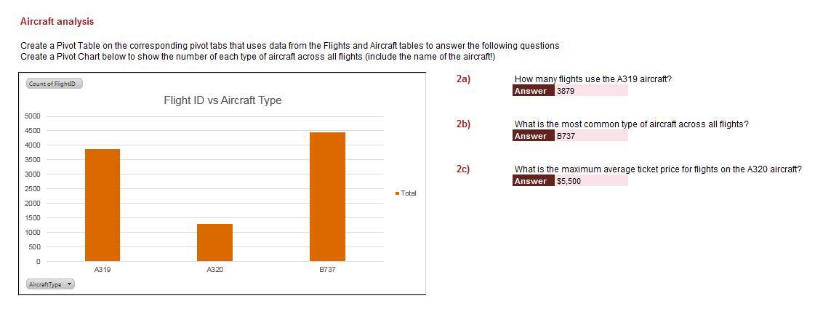
Logo here

Slide 5
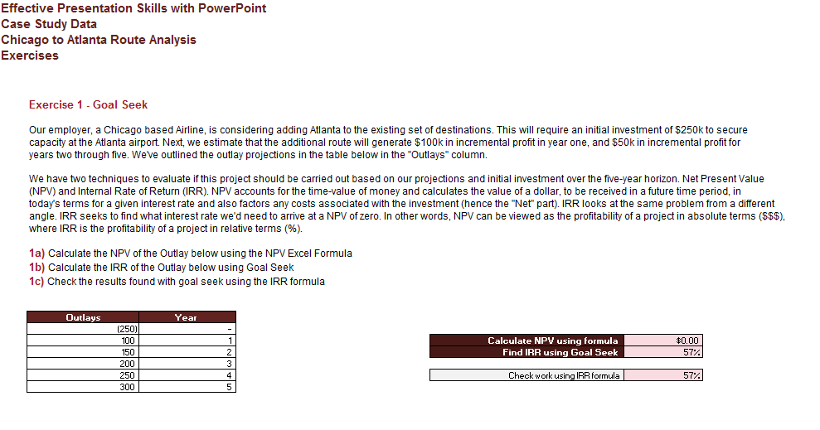
Logo here

Slide 6
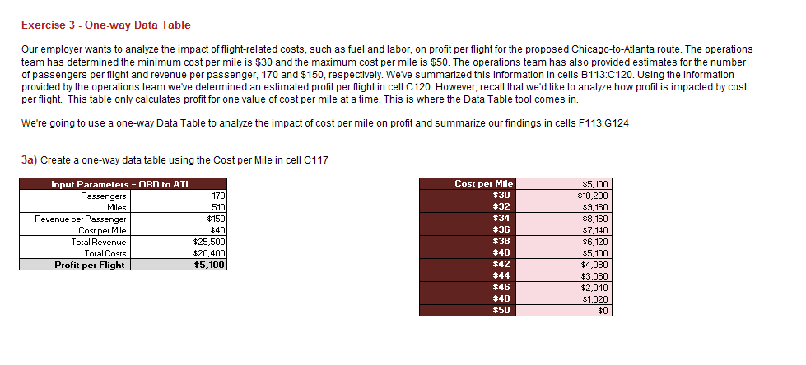
Logo here

Slide 7
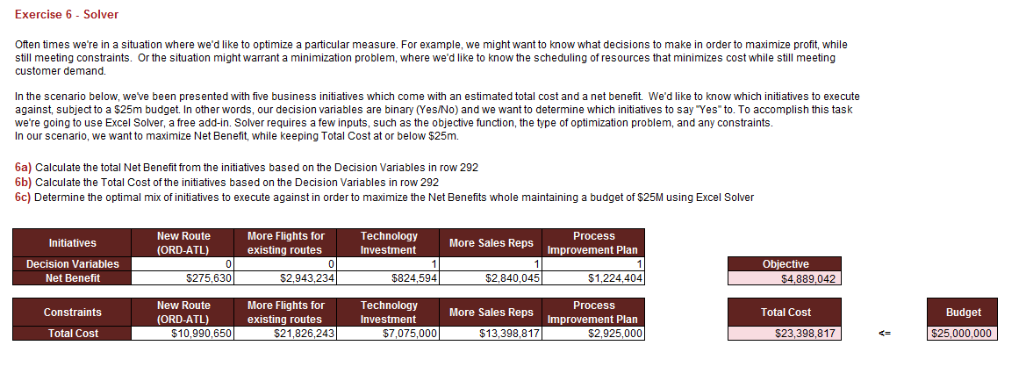
Logo here

Slide 8
THANK YOU!

